Slide 1


Monitoring Electricity Usage
Jasmine Brown, mathematics major, class of 2020
Clark Atlanta University

Slide 2
Problem Statement
The goal of the project is to use previous data from 2018 to create a forecasting model to predict the power usage of a given customer in 2019 and to discover trends associated with their average weekly and monthly power usage.

Slide 3
DATA
The data set is an hourly record of a customer’s power usage for one full year.
The data set has 24*365 = 8,760 observations.
There are eight variables in the data set. (Type the variables here)
Variable 1
Variable 2
Variable 3
Variable 4
Variable 5
Variable 6
Variable 7
Variable 8

Slide 4
Data Wrangling techniques USING EXCEL AND Rstudio
The data was presented in a structured format.
Dates were formatted using 2018 as the year to be easily read into R.
An additional column was created to record the total usage hourly for each variable.
Variables for the monthly and weekly moving average were created to smooth out short-term fluctuations and highlight longer-term trends in the electricity usage.

Slide 5
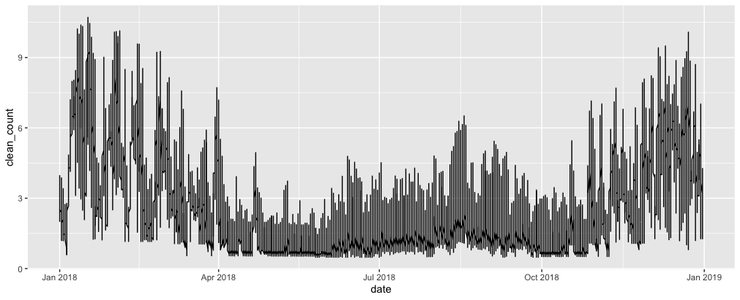
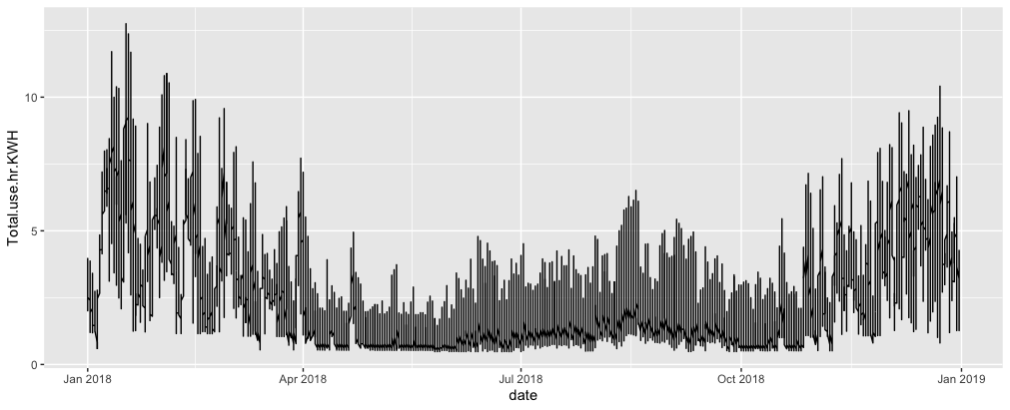
Verifying clean data
Date Versus Clean count
The time series clean function is used identify missing data and outliers.
The top plot shows the total usage over time.
The bottom plot shows the time series plot after the clean count function war applied.
Additional analysis and identical plots show that the data was clean.
Date Versus Total Usage

Slide 6
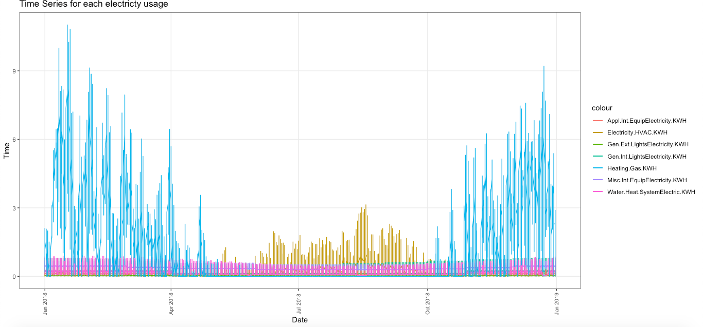
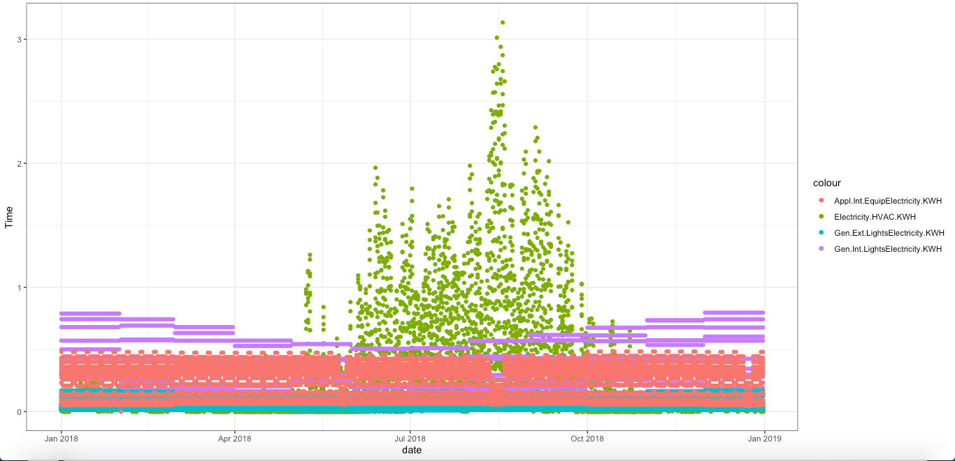
Exploratory Analysis
Variables Versus Date
This is a graph to show trends in the original data over the given time.
This plot highlights variables difficult to analyze in the first plot.

Slide 7
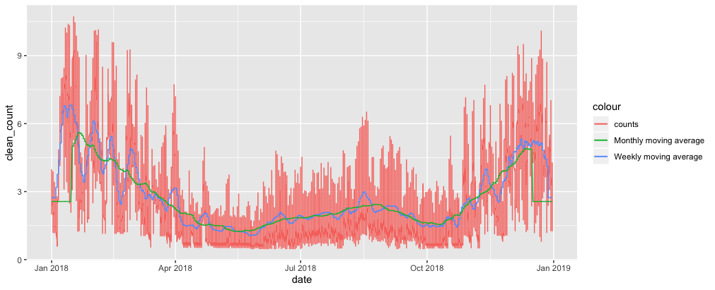
Moving averages
A moving average is a technique that calculates particular intervals of averages.
Two variables were created to calculate a monthly and weekly moving average from the total usage.
The replace function was used to replace the missing moving average data points with the mean of the total usage.
A comparative analysis of the plots are revealed.

Slide 8
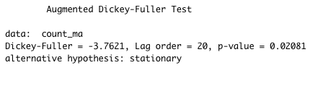
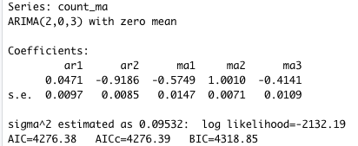
machine learning Technique
The data is stationary (variance=mean=covariance) because the Augmented Dickey Fuller (ADF) test recorded a p-value = 0.02.
The Integrated ARMA (ARIMA) model provides the optimal model (2,0,3) for forecasting a customer’s total electricity usage.
- to analysis total usage for this year consider the total usage from two months ago
- the difference is zero, thus the model confirms
that the data is stationary.
- consider the error term for total usage from
three months ago
There are five coefficients for particular time points that are used as a forecasting model.

Slide 9
Mathematical ARIMA Model

Slide 10
TRENDS, RESULTS, & Recommendations ANY questions!!!!!!
The usage decreases from January – April. It is constant from May – October. From November – December the usage increases.
A forecasting model was created to determine the customer’s future use. Which can be helpful to predict the customer’s bill over time.
Given the three trend intervals, there are seasonal trends. Decomposing data to remove seasonality will help smooth the data to improve predictions for the customer’s total electricity usage.

